Slide 1

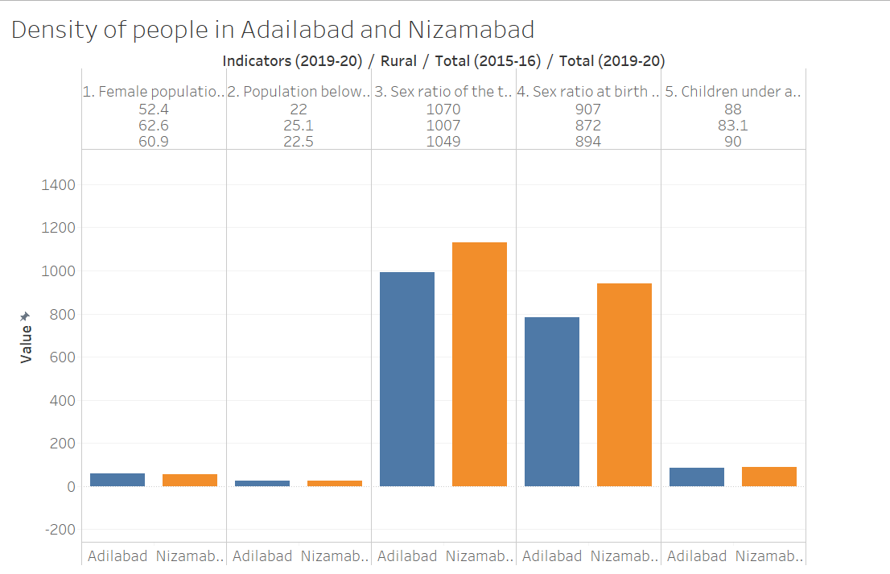
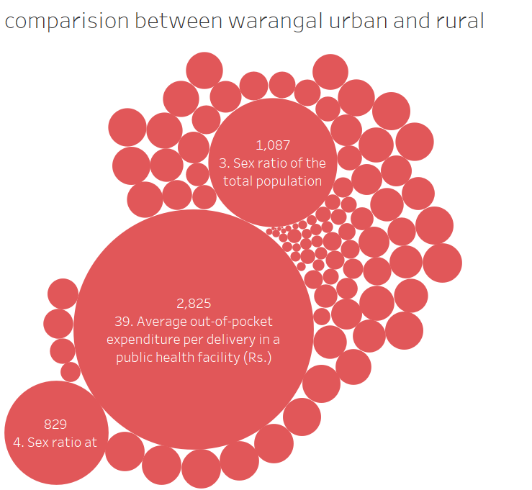
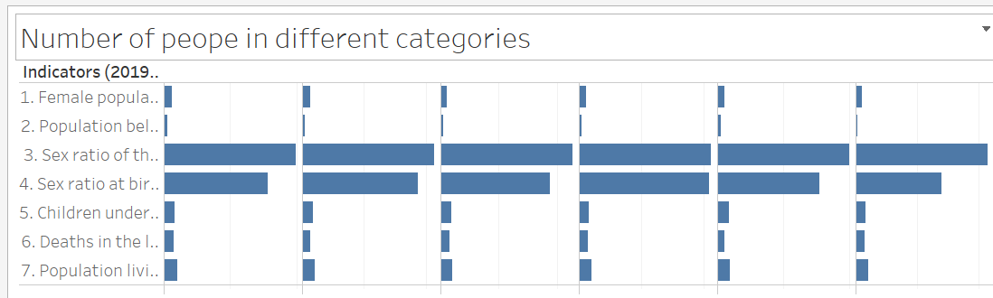
GOOD HEALTH AND WELL BEING
The sex ratio of Indian population has always been of topical interest for the demographers, social scientists, women’s groups, research scholars and various planners and policy makers. Why is it that India has such uneven composition of population as compared to most of the developed countries in the world? Several reasons are adduced to explain the consistently low levels of sex ratio and their further decline in the country. Some of the important reasons commonly put forward are listed below: Neglect of the girl child resulting in their higher mortality at younger ages .1) High maternal mortality 2)Sex selective female abortions
In 2018 an estimated 6.2 million children and adolescents under the age of 15 years died, mostly from preventable causes. Of these deaths, 5.3 million occurred in the first five years, with almost half of these in the first month of life.​​​​​ Malnourished children, particularly those with severe acute malnutrition, have a higher risk of death from common childhood illness such as diarrhoea, pneumonia, and malaria. Nutrition-related factors contribute to about 45 per cent of deaths in children under five years of age.
Significant strides were made in increasing life expectancy and reducing some of the common killers associated with child and maternal mortality. ​​​​But more efforts are needed to fully eradicate a wide range of diseases and address many different persistent and emerging health issues. By focusing on providing more efficient funding of health systems, improved sanitation and hygiene, and increased access to physicians, significant progress can be made in helping to save the lives of millions.
Conclusion:
The Sustainable Development Goal 3 rankings in Telangana pose a worrying trend for the State amidst a raging pandemic. As per the same, even though the State’s overall performance in the SDG-3 “Good Health and Well being” section has improved, it’s performance has worsened in some fronts, especially regarding recruiting healthcare workforce.As per this facet of the SDG Goal 3 ranking, which is on the number of nurses, midwives and physicians working per 10,000 population, the number of workers has fallen from 11 to 10 — indicating a downward trend. This is far off from the global target as well.

